Slide 1
Muhammed Tawfiq Chowdhury Data Structure Section 1 and 2 Stack

Slide 2
What is a Stack
The stack is a linear data structure that is used to store the collection of objects. It is based on Last-In-First-Out (LIFO). Java collection framework provides many interfaces and classes to store the collection of objects. One of them is the Stack class that provides different operations such as push, pop, search, etc.
The stack data structure has the two most important operations that are push and pop. The push operation inserts an element into the stack and pop operation removes an element from the top of the stack.

Slide 3
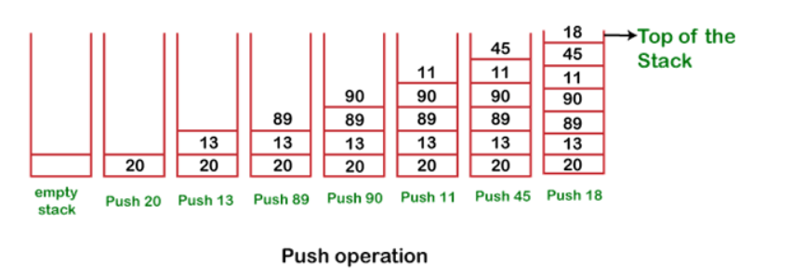
Push

Slide 4
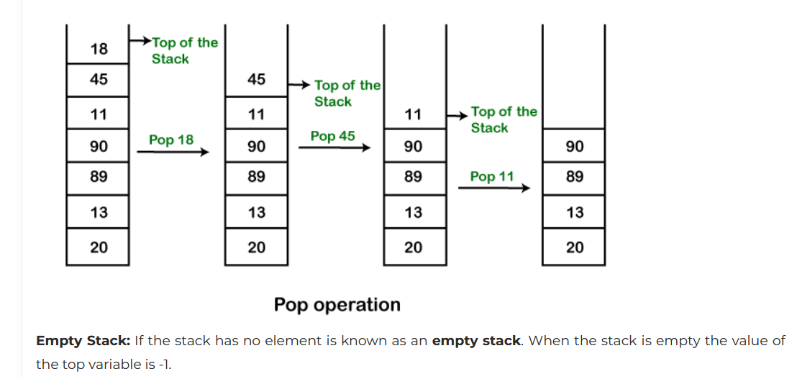
Pop

Slide 5
Hierarchy of Stack Class
Java Collection framework provides a Stack class that models and implements a Stack data structure. The class is based on the basic principle of last-in-first-out. In addition to the basic push and pop operations, the class provides three more functions of empty, search, and peek. The Stack class extends Vector and provides additional functionality specifically for stack operations, such as push, pop, peek, empty, and search. The Stack class can indeed be referred to as a subclass of Vector, inheriting its methods and properties.

Slide 6
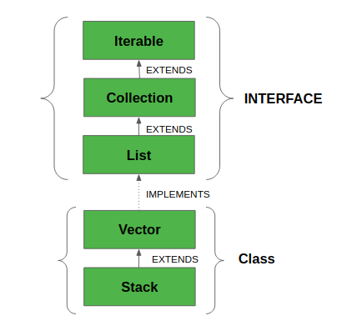
Hierarchy of Stack Class

Slide 7
What is Iterable?
The Iterable interface was introduced in JDK 1.5. It belongs to java.lang package. In general, an object Implementing Iterable allows it to be iterated. An iterable interface allows an object to be the target of enhanced for loop(for-each loop).
public interface Iterable<T>
{
Iterator<T> iterator();
Spliterator<T> spliterator();
void forEach(Consumer<? super T> action);
}

Slide 8
What is a Vector?
Vector data structure is like the dynamic array which can grow or shrink its size. Unlike array, we can store n-number of elements in it as there is no size limit. It is a part of Java Collection framework since Java 1.2. It is found in the java.util package and implements the List interface, so we can use all the methods of List interface here.
It is recommended to use the Vector class in the thread-safe implementation only. If you don't need to use the thread-safe implementation, you should use the ArrayList, the ArrayList will perform better in such case.

Slide 9
Create a Stack
In order to create a stack, we must import java.util.stack package and use the Stack() constructor of this class. The below example creates an empty Stack.
Stack<E> stack = new Stack<E>();

Slide 10
Methods in Stack Class
empty() It returns true if nothing is on the top of the stack. Else, returns false
peek() Returns the element on the top of the stack, but does not remove it
pop() Removes and returns the top element of the stack. An ‘EmptyStackException’ is thrown if we call pop() when the invoking stack is empty
push(Object element) Pushes an element on the top of the stack
search(Object element) It determines whether an object exists in the stack. If the element is found. It returns the position of the element from the top of the stack. Else, it returns -1.

Slide 11
Applications of Stacks
Function calls: Stacks are used to keep track of the return addresses of function calls, allowing the program to return to the correct location after a function has finished execution
Recursion: Stacks are used to store the local variables and return addresses of recursive function calls, allowing the program to keep track of the current state of the recursion.
Memory management: Stacks are used to allocate and manage memory in some operating systems and programming languages.

Slide 12
Advantages of Stacks
Simplicity: Stacks are a simple and easy-to-understand data structure, making them suitable for a wide range of applications.
Efficiency: Push and pop operations on a stack can be performed in constant time (O(1)), providing efficient access to data.
Last-in, First-out (LIFO): Stacks follow the LIFO principle, ensuring that the last element added to the stack is the first one removed. This behavior is useful in many scenarios, such as function calls and expression evaluation.
Limited memory usage: Stacks only need to store the elements that have been pushed onto them, making them memory-efficient compared to other data structures.

Slide 13
Disadvantages of Stacks
Limited access: Elements in a stack can only be accessed from the top, making it difficult to retrieve or modify elements in the middle of the stack.
Potential for overflow: If more elements are pushed onto a stack than it can hold, an overflow error will occur, resulting in a loss of data.
Not suitable for random access: Stacks do not allow for random access to elements, making them unsuitable for applications where elements need to be accessed in a specific order.
Limited capacity: Stacks have a fixed capacity, which can be a limitation if the number of elements that need to be stored is unknown or highly variable.

